Slide 1





Library DBMS CLI Presenters:
Hadeel Alnumiri
Milad Torang
Hojjatollah Saeedi
Nasir Ahmad Dastgirzada

Slide 2


Agenda
Introduction
Features Overview
Conclusion
ERD Diagram- Impelemantation
ERD Diagram-Implementation

Slide 3

Introduction
The Library CLI Application revolutionizes library management by providing a streamlined solution through text-based commands.

Slide 4
Features Overview:
Here's a step-by-step walkthrough of user interactions in the CLI Application:
Start: Launching the Library CLI.
Sign_up: Sign up a new user.
Delete_user: Delete a user from the database.
Sign_in: Sign in a user.
Search_by_name: Search for books by name.
Search_by_author: Search for books by author.
Most_read_books: Display the 10 most-read books.
Recently_added: Display the 5 most recent books added.
Most_read_genres: Display the 5 most-read genres.
Most_read_authors: Display the 3 most-read authors.
Add_book: Add a book to the database.
Delete_book: Delete a book from the database.
Borrow_book: Borrow a book from the library.
Return_book: Return a borrowed book to the library.
Mark_read: Mark a book as read.
Fav_book: Add a book to favorites.
My_books: View user's books.
Statistics: View user's reading statistics.

Slide 5
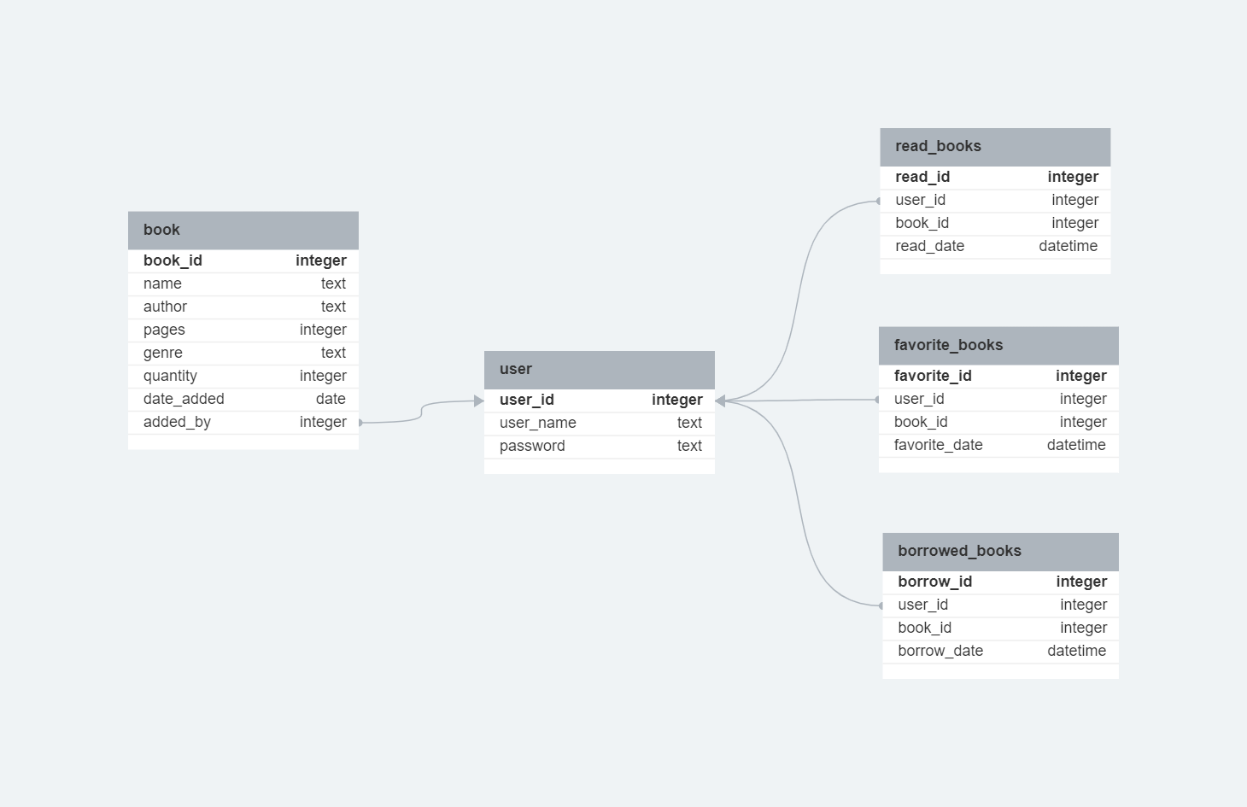
ERD diagram - implementation

Slide 6

Conclusion
The CLI Application streamlines library management, offering:
Efficiency
Accuracy
Accessibility
Centralizes data
Scales
Effectively
Cost-effective

Slide 7


THANK YOU
Hadeel Alnumiri
Milad Torang
Hojjat Ollah Saeedi
Nasir Ahmad Dastgirzada

